Slide 1

Demographic disparities after the COVID-19 Pandemic: immediate consequences or deeper remnants
By Pedro Huet

Slide 2
A Legacy of Disparities
The US has a history of disparities among different demographic groups: inequality in the treatment of racial, religious and ethnic minorities.
The situation has been recognized and there have even been improvements (establishment of citizenship and rights) to ameliorate it.
Instead of asking if these differences have been addressed, it would be better to ask, could these initial disparities among demographic groups have lingering gaps?
Since the topic is especially relevant in the realm of education, as it has been found to be among the most reliable vehicles of social mobility (Folger & Nam, 1964), perhaps a good way of answering is observing what happened to demographic groups’ educational attainment before and after the COVID-19 pandemic.
Using timeseries data from the Chicago Public School district, it is possible to evaluate the trends of how different demographic groups fared after the pandemic.

Slide 3
Hypothesis & Methodology
Hypothesis:
H1o: There should be no noticeable differences between the academic performance of different racial/ethnic groups (4 largest in Chicago).
H2o: There should be no noticeable differences between the mean performance by sex among the racial/ethnic groups (4 largest in Chicago).
Methodology:
Timeseries analysis: the order of the observations is important, as opposed to weighting each observation the same or giving them a random value.
Regression discontinuity approach: school year as running variable | 2020 – 2021 as cut-off point; racial/ethnic and gender as points of comparison.
School Performance: metrics based on high school performance on standardized tests (9th 10th and 11th grade), to account for variance in internal grading standards.

Slide 4
Post Pandemic trends
Having transitioned from a global pandemic, the schooling landscape in Chicago has changed. Using the trends from Grades 9 – 11 from Chicago Public Schools, we see that:
Grade 10 and 11 Students’ College Readiness levels were mostly stable before the 2020 – 2021 school year, while Grade 9 were actually on the rise.
Starting the 2020 – 2021 school year, these three student groups’ grades decreased dramatically by around 20%).
During the 2021 – 2022 and 2022 – 2023 school years, all grades saw a slight increase in their standing, yet still far from the pre-pandemic baseline.

Slide 5
The Average PSAT/SAT and specific Math Score trends mostly reflect the same tendency.

Slide 6
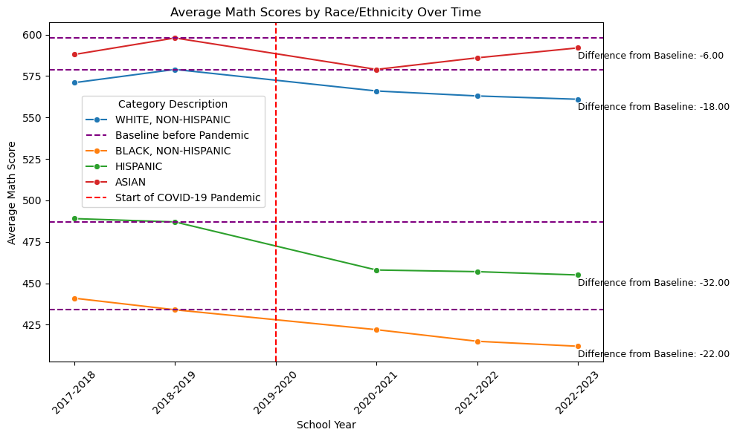
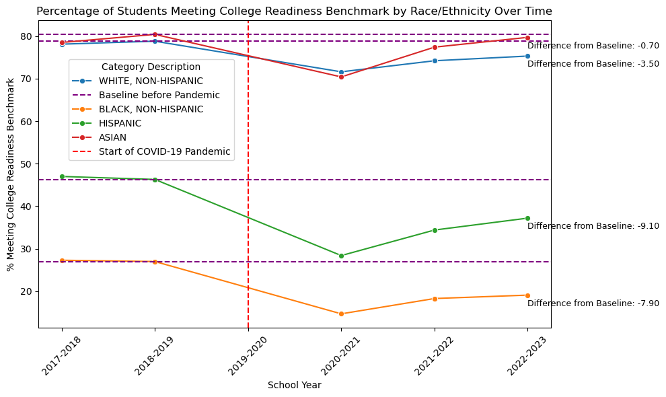
Trends by demographic group
When disaggregating the data and looking into the trends by demographic group, the picture seems different. The mean decrease of math test results for these students varied widely by demographic group:
1. Decrease in test scores:
Caucasian and Asian students experienced only a small relative decrease in their pre-college test scores (still above 550) during the pandemic and, in the case of the latter, seemed to have recovered relatively fast (1% vs 3% net decrease post-pandemic).
African American and Hispanic students had a larger drop in their pre-college test scores (5% and 6.5%, respectively), and remained in noticeably lower brackets (< 420 for African Americans).
2. Analogous trend in college readiness criteria:
< 1% decrease for Asians and 3.5% for Caucasians .
> 9% decrease for Hispanics and 8% for African Americans.
Note: grade means were aggregated to observe estimated decrease in 2020 - 2021

Slide 7
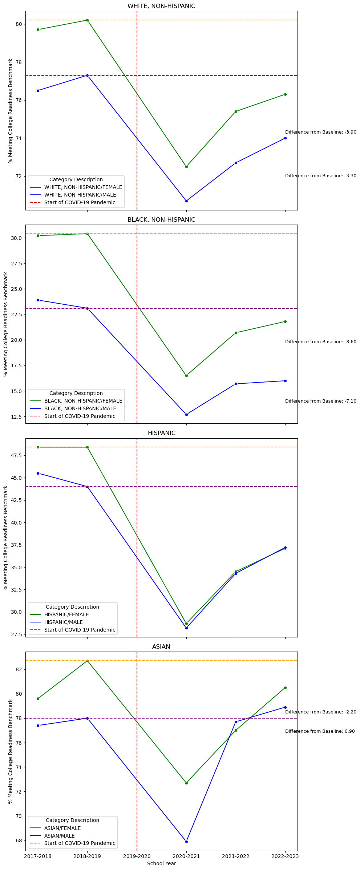
When further disaggregating the data, we observe that female students among minority groups were the most affected by the pandemic: 1) their performance
fell compared to males among African Americans; 2) fell until it matched their male counterparts among the Hispanics, as well as their 3) results actually became
comparatively worse to those of their male counterparts among Asians.

Slide 8
Going forward: Policy suggestions
Based on the available information, the evidence points towards:
Although much of the COVID-19 pandemic has already passed, the phenomenon has generated noticeable structural changes in the general trends for high school students’ performance. While this can be attributed to numerous factors, the COVID-19 pandemic is the clearly a culprit due to the dramatic changes in trends during the cut-off point (school year 2020 – 2021).
Disaggregating the data shows that the process did not affect the district’s students equally:
Students from the Hispanic and African American demographic groups have been noticeably more negatively affected by the Covid-19 Pandemic in terms of their learning outcome, compared to Caucasian and Asian students.
There are reasons to believe that there is an interaction between the race and gender gap in the learning loss among Chicago Public School Students, as female students among the 3 most numerous minority groups in Chicago experienced a noticeably greater learning losses than their male counterparts. These are possible remnants of historical disparities.
Some policy solutions to ameliorate the situation come to mind:
A good first step would be to observe the allocation of funds and teacher feedback among schools in the district; could there be some correlation between the funding, number of enrolled students or professor feedback of each public school and their students’ performance? If not, what other variables could be affecting the situation (food deserts, lack of public infrastructure)?
To incentivize a stronger performance, would it be viable to target students of certain demographic groups a merit-based stipend for their performance or additional courses? This could motivate parents to continue nurturing the education of their child while mitigating their household expenses, or offer them greater targeted learning opportunities.
A more ambitious strategy could be thinking of programs for schools to offer optional extended hours to students during the week, as this could allow them to catch up on concepts and allow their parents to dedicate more time to labor with the comfort of knowing their child is being taken care of.

